Slide 1

Made By: Farnam Fahim
Class: Introduction to Computers

Slide 2
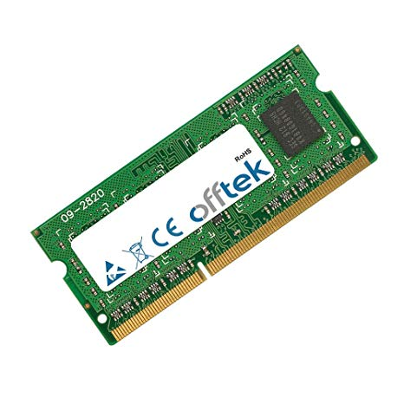
RAM (Random Access Memory)
Volatile Memory
Fast but not Infinite
Maximum Size

Slide 3
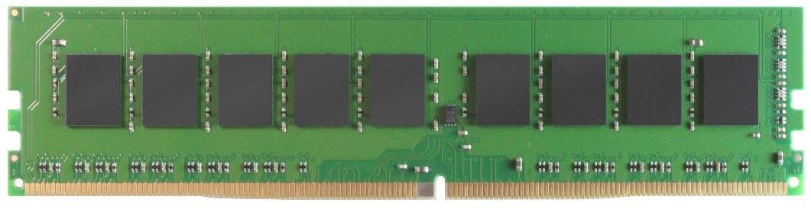
Types of RAM
Two types of RAM
DRAM
Dynamic Random Access Memory
Continuously Refreshed
Slow
SRAM
Static Random Access Memory
Fast
Used in CPU

Slide 4
Types of DRAM
Two types of DRAM
SDRAM
Synchronous Dynamic Random Access Memory
SDRAM > DRAM
It’s Synched with Clock
Measured in Hz
DDR SDRAM
Double Date Rate SDRAM
DDR SDRAM > SDRAM
Electrical Power
Best RAM in Market

Slide 5


What Is Clock Speed?
Fetch- Execute Cycle
Take, Read and Execute
Clock Speed
Speed of the Fetch- Execute Cycle
Types of Clock Speed
Overclocking
Accelerate its maximum speed
Power consumption
Dangerous
Underclocking
Lower Speed
Power Consumption
Safe

Slide 6
Cache
Fastest memory
Uses SRAM
Closest memory to CPU
Organized on hierarchy. ( L1, L2, L3, …)
Storage Device
RAM
Cache
CPU

Slide 7
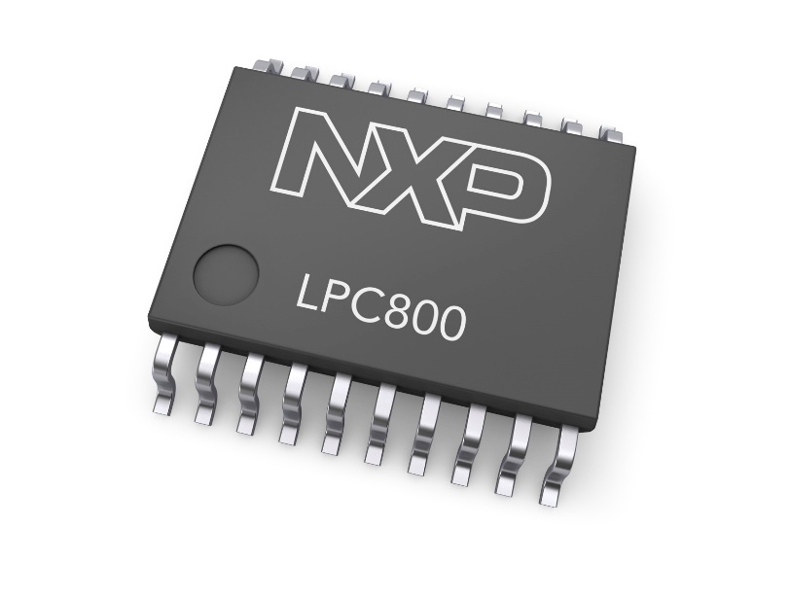
Non-volatile Memory
ROM (Read Only Memory)
Modified or written
Contains the BIOS
CMOS (Complementary Metal-Oxide Semiconductor)
Correct computer functionality
Has its own battery

Slide 8
Types of ROM
PROM (Programmable)
EPROM (Erasable Programmable)
EEPROM (Electrical Erasable)

Slide 9
Thank you for your time

